Slide 1

Digital Logic Design

Slide 2
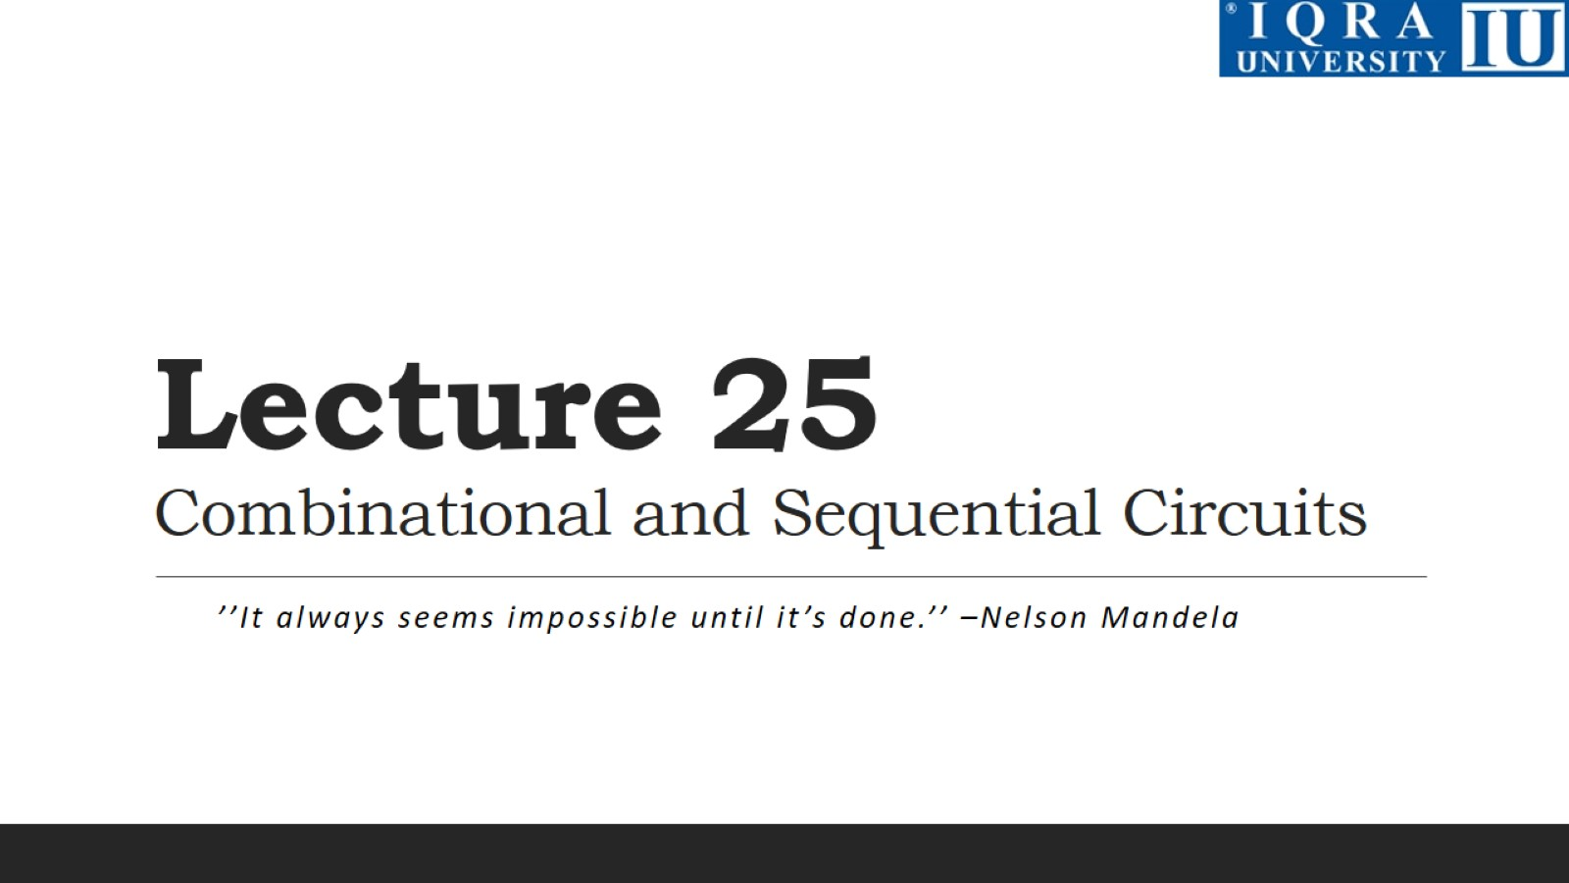
Lecture 25 Combinational and Sequential Circuits

Slide 3
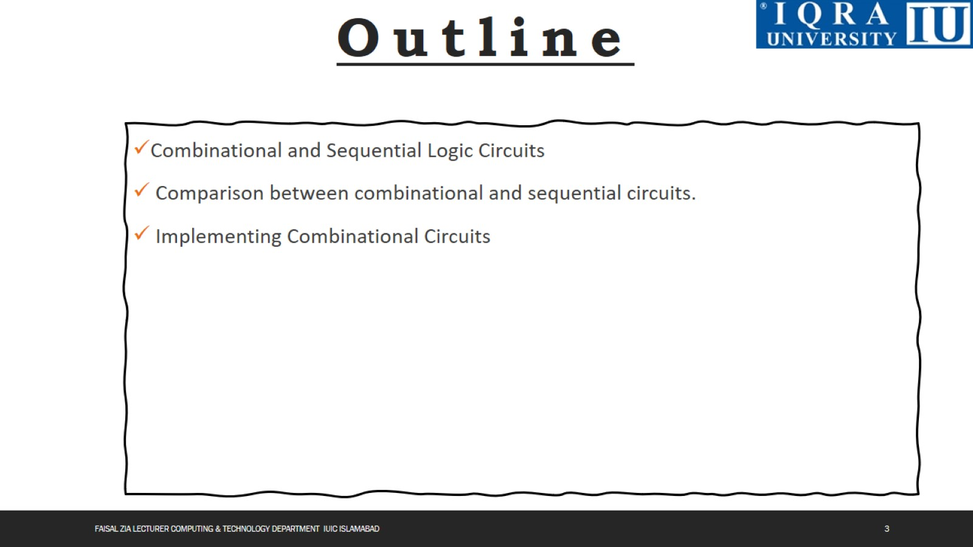

Slide 4
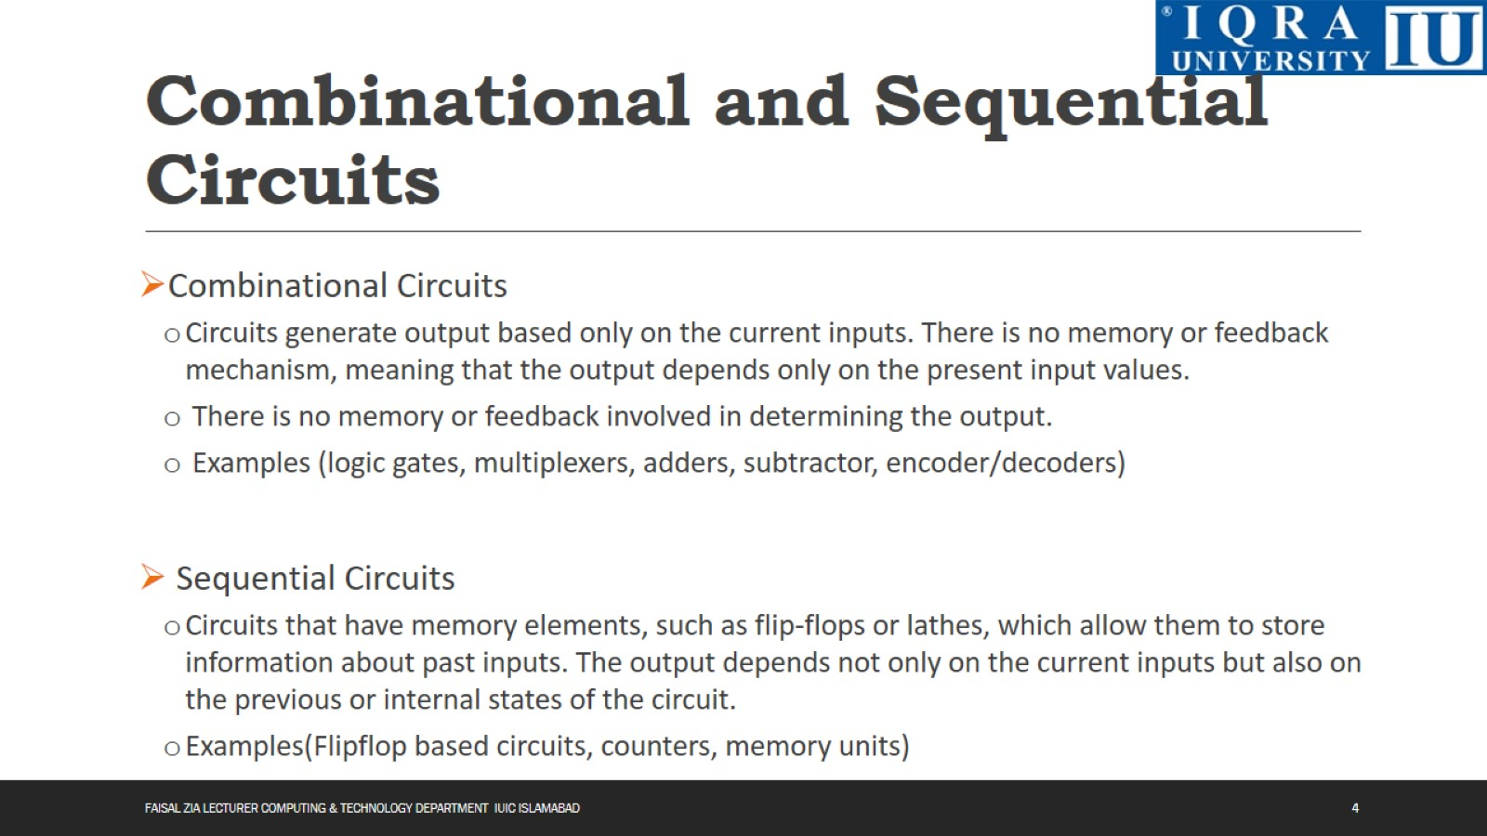
Combinational and Sequential Circuits

Slide 5
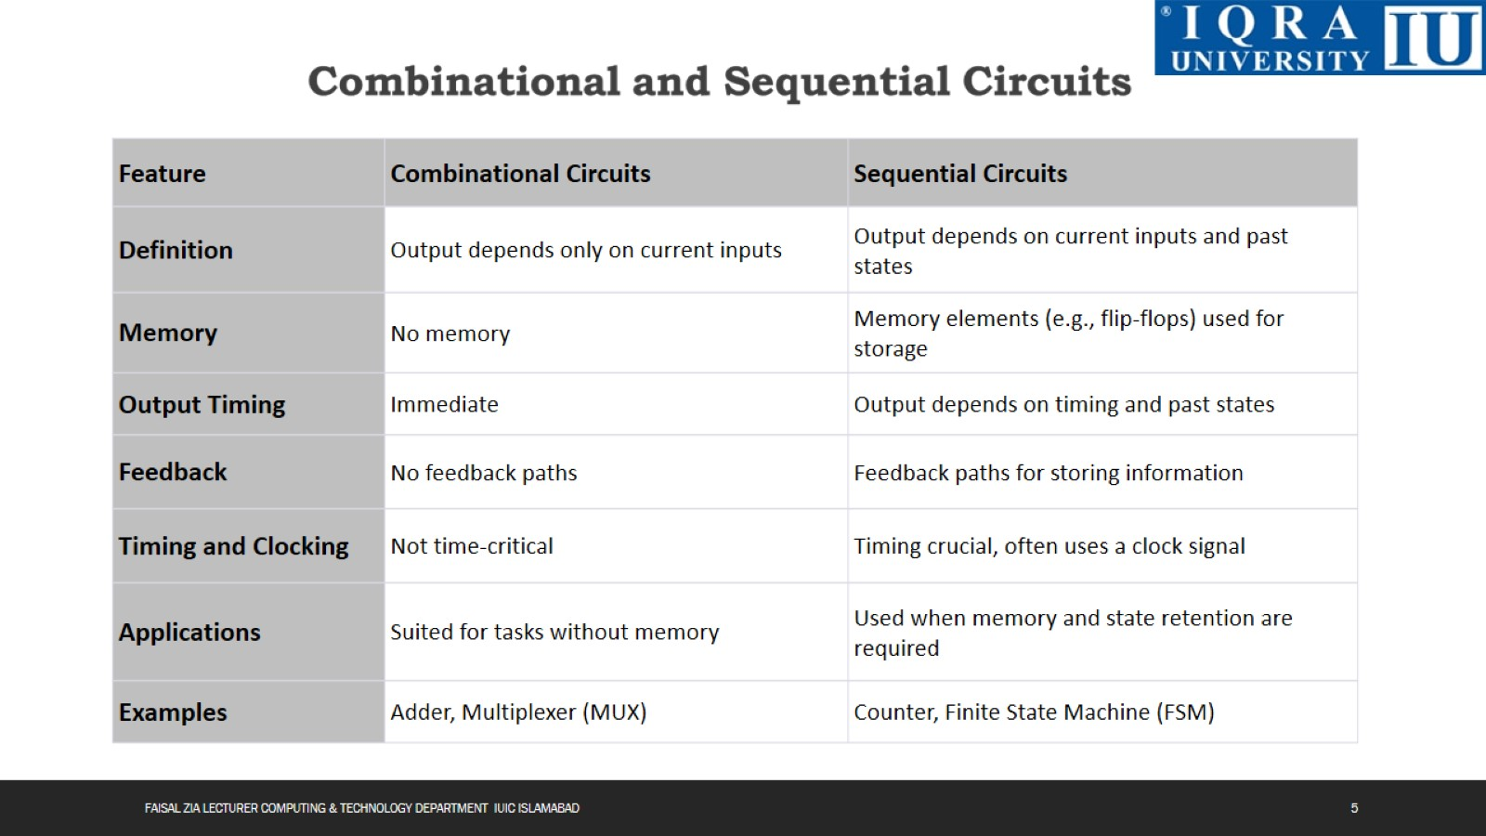

Slide 6
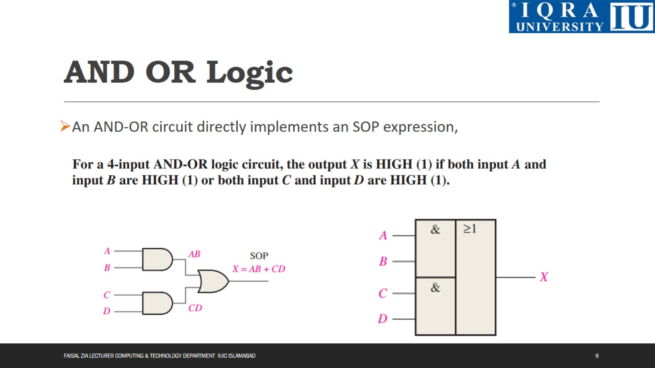
AND OR Logic

Slide 7
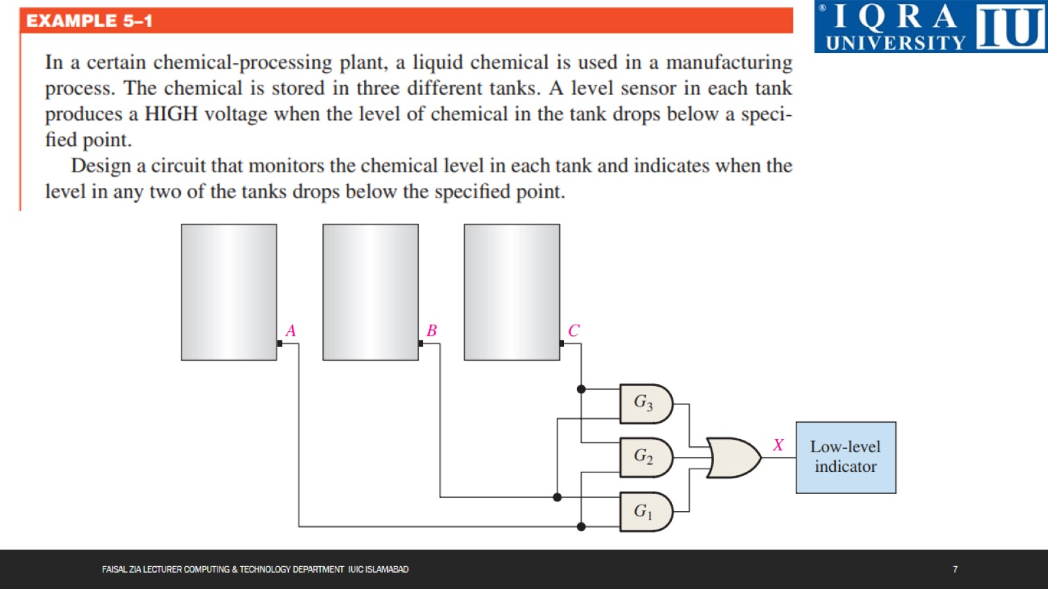

Slide 8
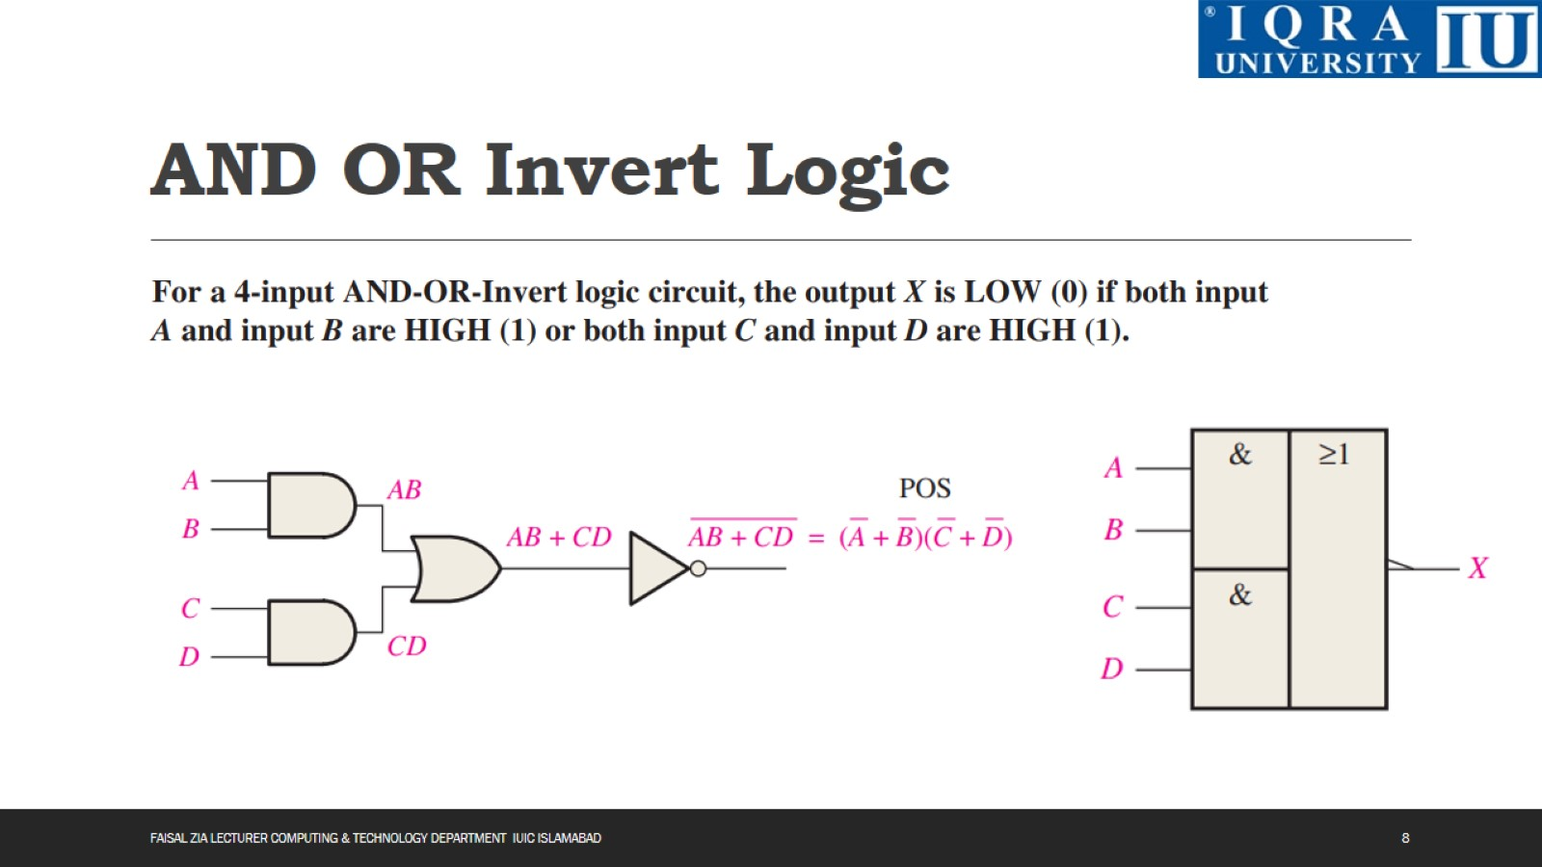
AND OR Invert Logic

Slide 9
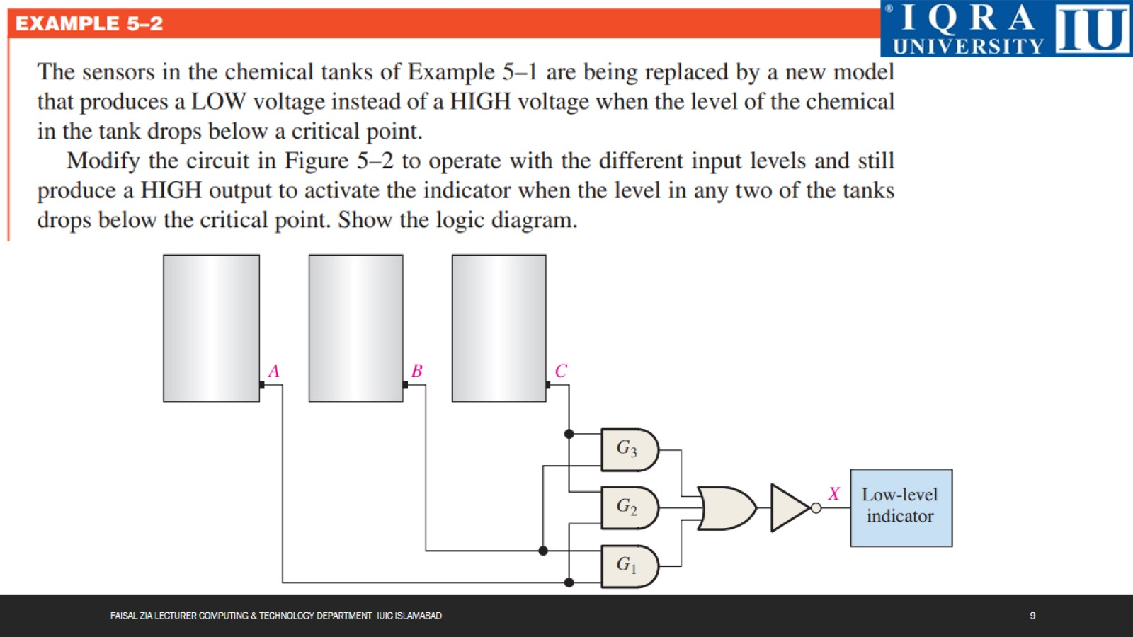

Slide 10
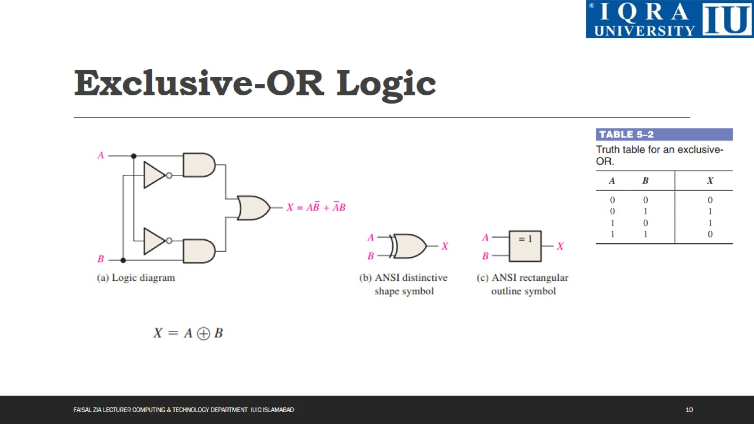
Exclusive-OR Logic

Slide 11
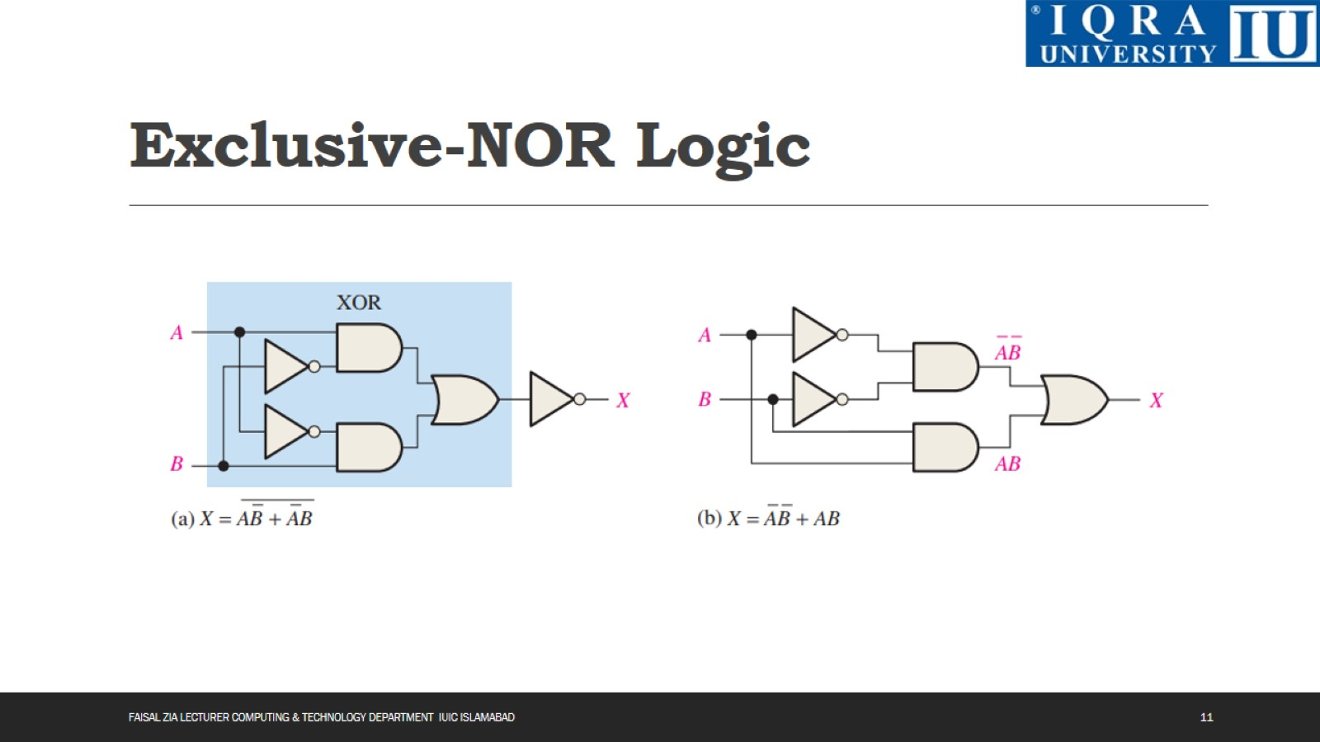
Exclusive-NOR Logic

Slide 12
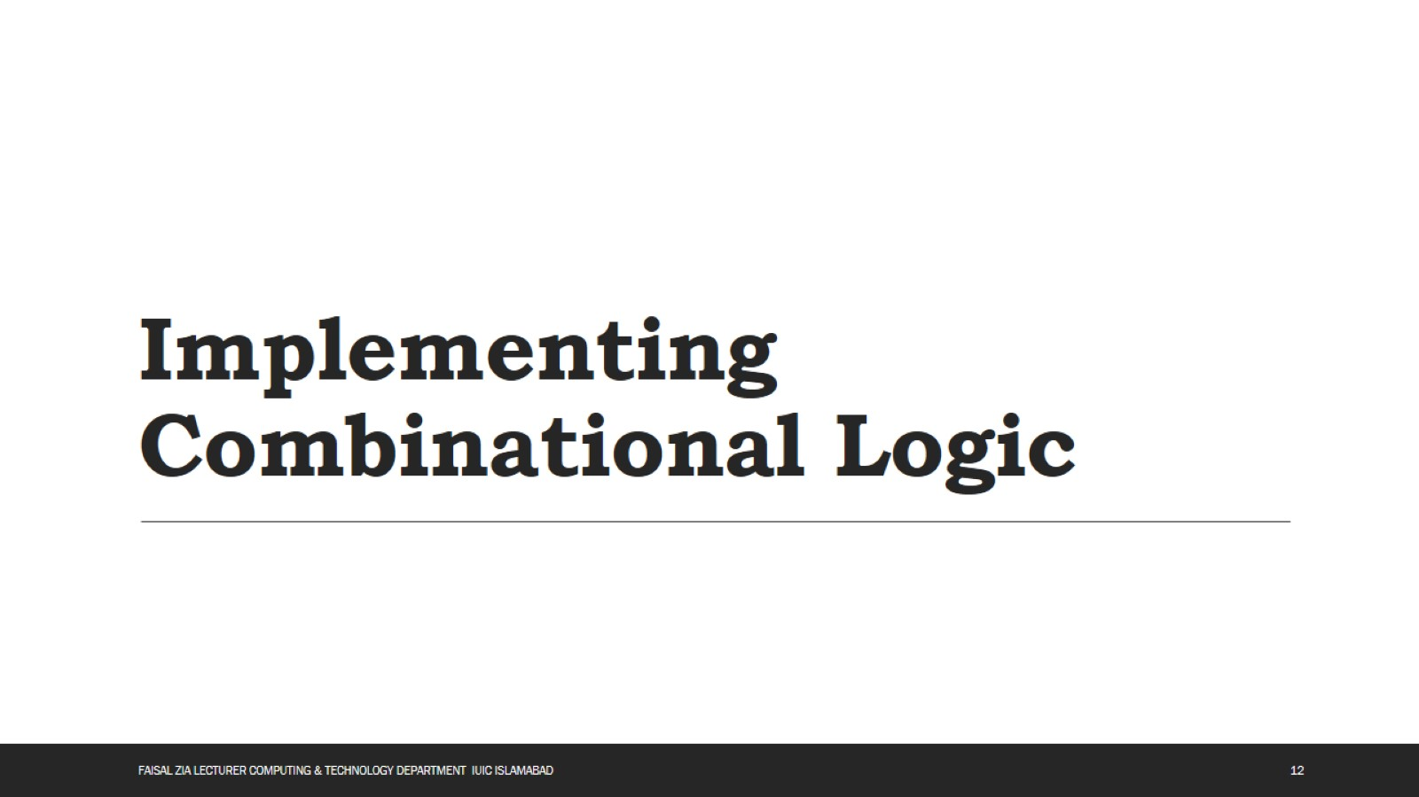
Implementing Combinational Logic

Slide 13
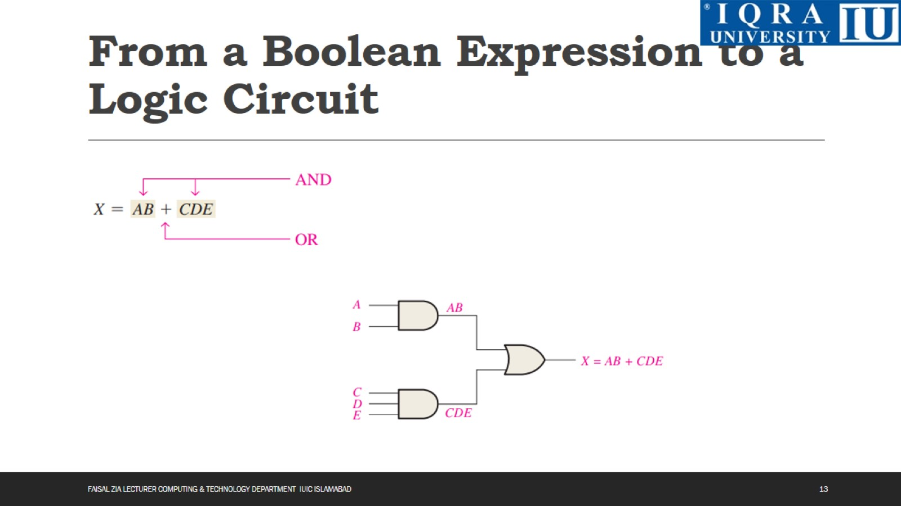
From a Boolean Expression to a Logic Circuit

Slide 14
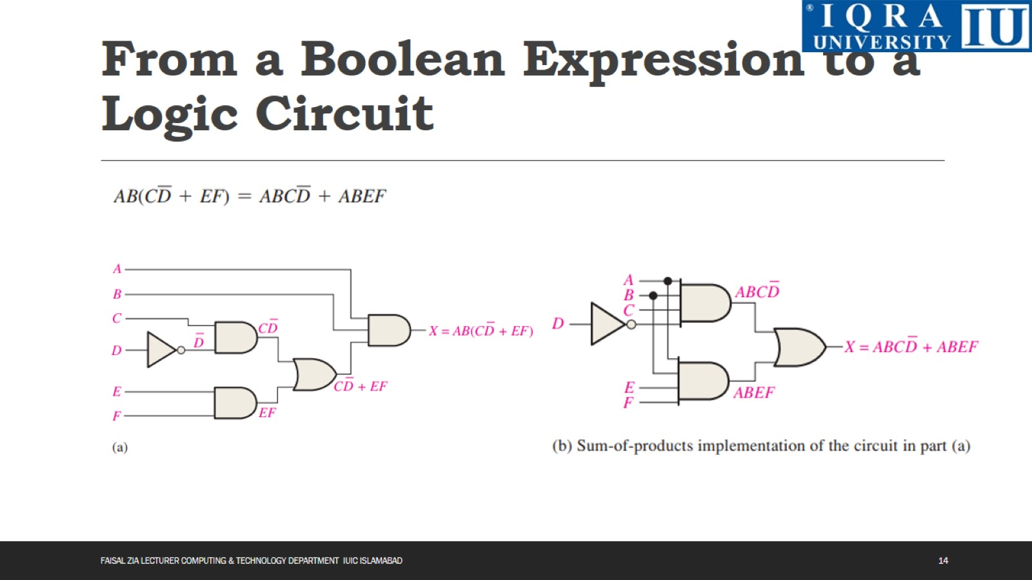
From a Boolean Expression to a Logic Circuit

Slide 15
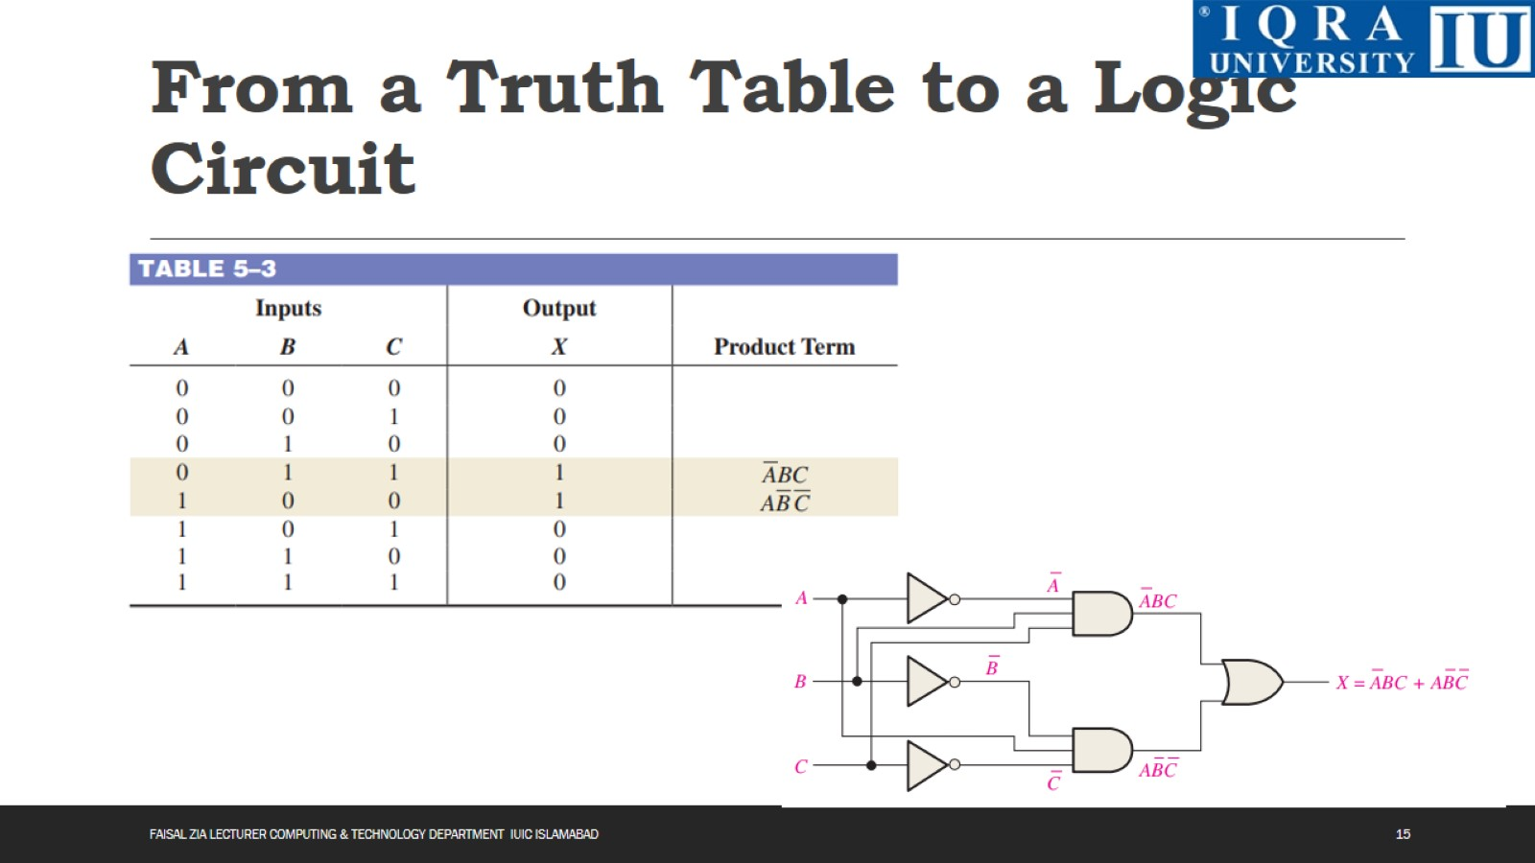
From a Truth Table to a Logic Circuit

Slide 16
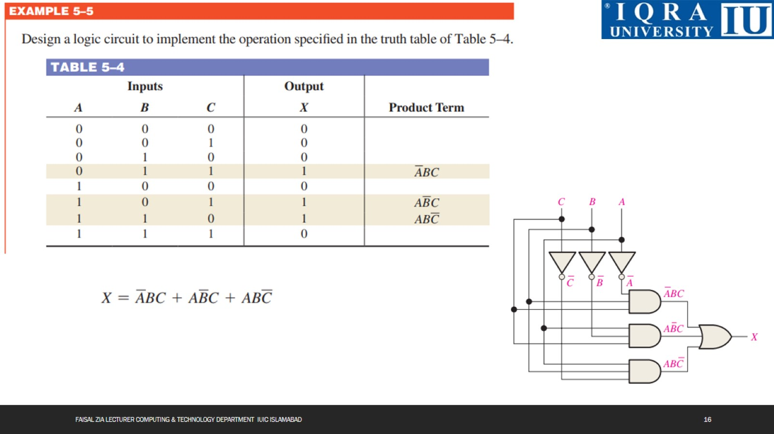

Slide 17
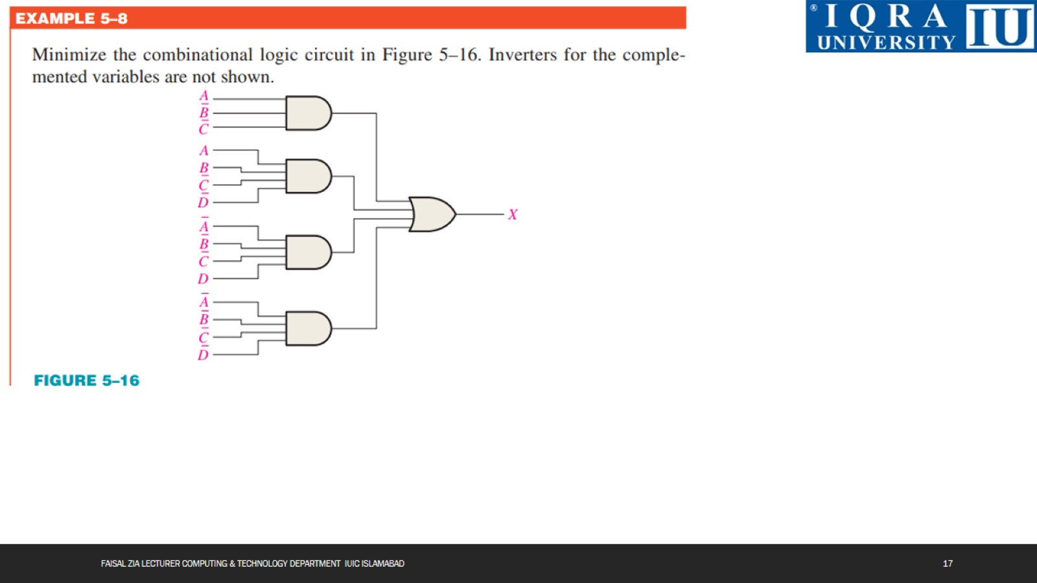

Slide 18
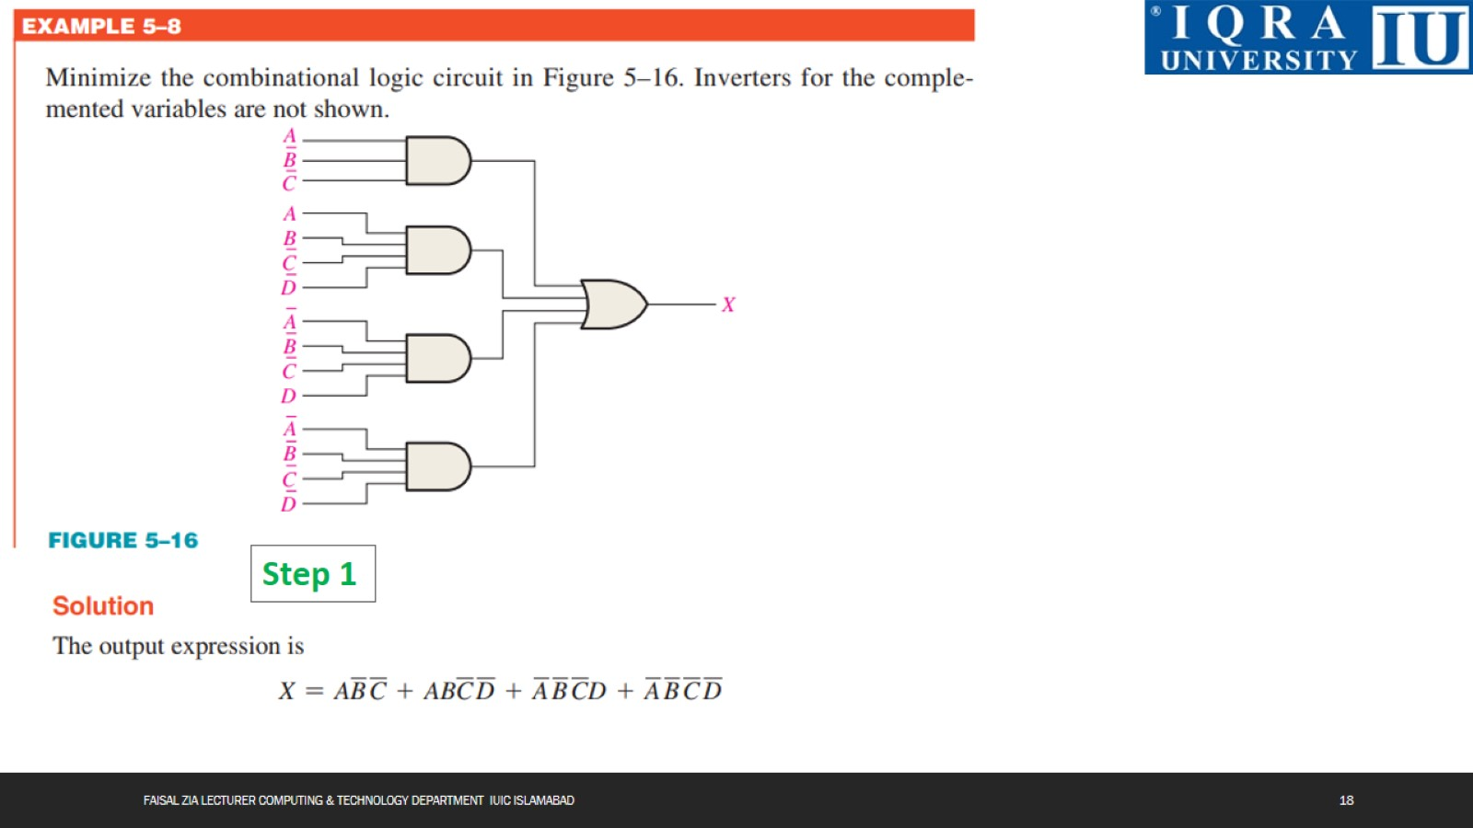

Slide 19
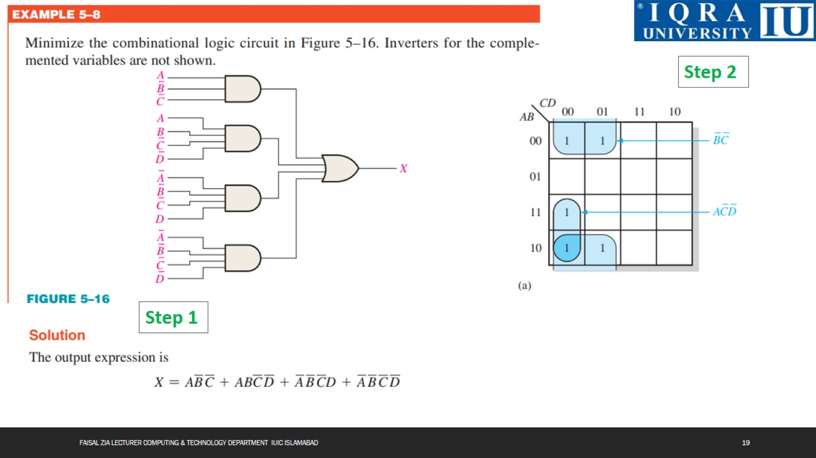

Slide 20


Slide 21
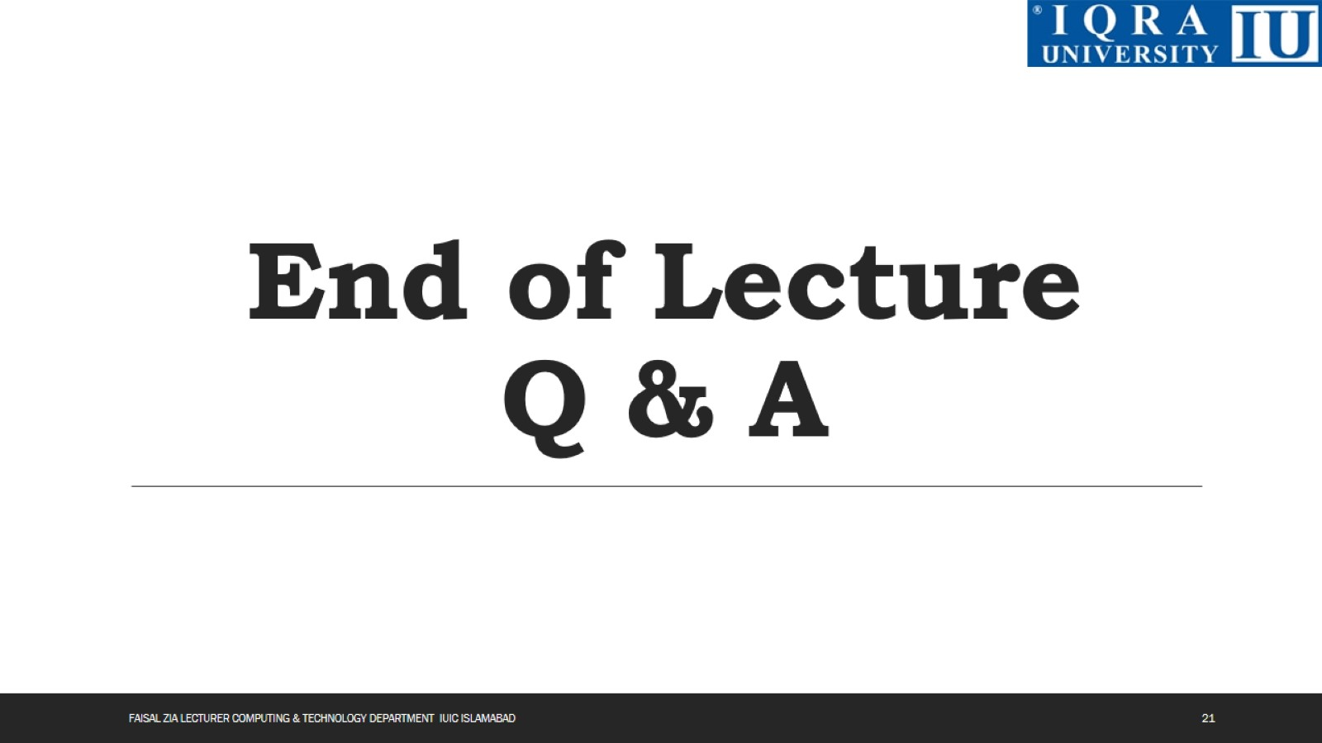
End of Lecture Q & A

